Slide 1
Basic VHDL Concepts
Interfaces
Behavior
Structure
Test Benches
Analysis, elaboration, simulation
Synthesis

Slide 2
Modeling Interfaces
Entity declaration
  describes the input/output ports of a module
entity name
port names
port mode (direction)
entity reg4 is
port ( d0, d1, d2, d3, en, clk : in bit;
q0, q1, q2, q3 : out bit );
end entity reg4;
punctuation
reserved words
port type

Slide 3
Modeling Behavior
Architecture body
  describes an implementation of an entity
  may be several per entity
Behavioral architecture
  describes the algorithm performed by the module
  contains
    process statements, each containing
    sequential statements, including
    signal assignment statements and
    wait statements

Slide 4
Behavior Example
architecture behav of reg4 is
begin
storage : process is
variable stored_d0, stored_d1, stored_d2, stored_d3 : bit;
begin
if en = '1' and clk = '1' then
stored_d0 := d0;
stored_d1 := d1;
stored_d2 := d2;
stored_d3 := d3;
end if;
q0 <= stored_d0 after 5 ns;
q1 <= stored_d1 after 5 ns;
q2 <= stored_d2 after 5 ns;
q3 <= stored_d3 after 5 ns;
wait on d0, d1, d2, d3, en, clk;
end process storage;
end architecture behav;

Slide 5
Modeling Structure
Structural architecture
  implements the module as a composition of subsystems
  contains
    signal declarations, for internal interconnections
      the entity ports are also treated as signals
    component instances
      instances of previously declared entity/architecture pairs
    port maps in component instances
      connect signals to component ports
    wait statements

Slide 6
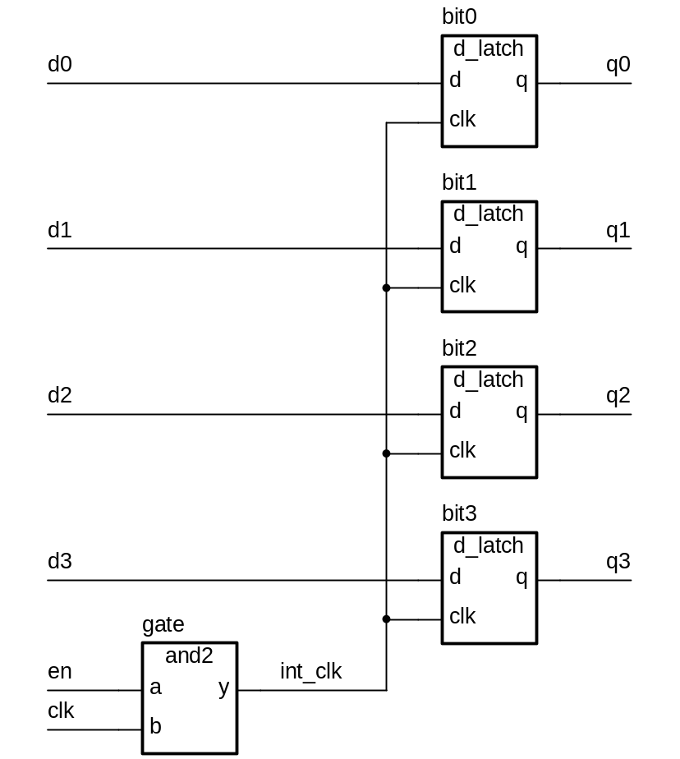
Structure Example

Slide 7
Structure Example
First declare D-latch and and-gate entities and architectures
entity d_latch is
port ( d, clk : in bit; q : out bit );
end entity d_latch;
architecture basic of d_latch is
begin
latch_behavior : process is
begin
if clk = ‘1’ then
q <= d after 2 ns;
end if;
wait on clk, d;
end process latch_behavior;
end architecture basic;
entity and2 is
port ( a, b : in bit; y : out bit );
end entity and2;
architecture basic of and2 is
begin
and2_behavior : process is
begin
y <= a and b after 2 ns;
wait on a, b;
end process and2_behavior;
end architecture basic;

Slide 8
Structure Example
Now use them to implement a register
architecture struct of reg4 is
signal int_clk : bit;
begin
bit0 : entity work.d_latch(basic)
port map ( d0, int_clk, q0 );
bit1 : entity work.d_latch(basic)
port map ( d1, int_clk, q1 );
bit2 : entity work.d_latch(basic)
port map ( d2, int_clk, q2 );
bit3 : entity work.d_latch(basic)
port map ( d3, int_clk, q3 );
gate : entity work.and2(basic)
port map ( en, clk, int_clk );
end architecture struct;

Slide 9
Mixed Behavior and Structure
An architecture can contain both behavioral and structural parts
  process statements and component instances
    collectively called concurrent statements
  processes can read and assign to signals
Example: register-transfer-level model
  data path described structurally
  control section described behaviorally

Slide 10
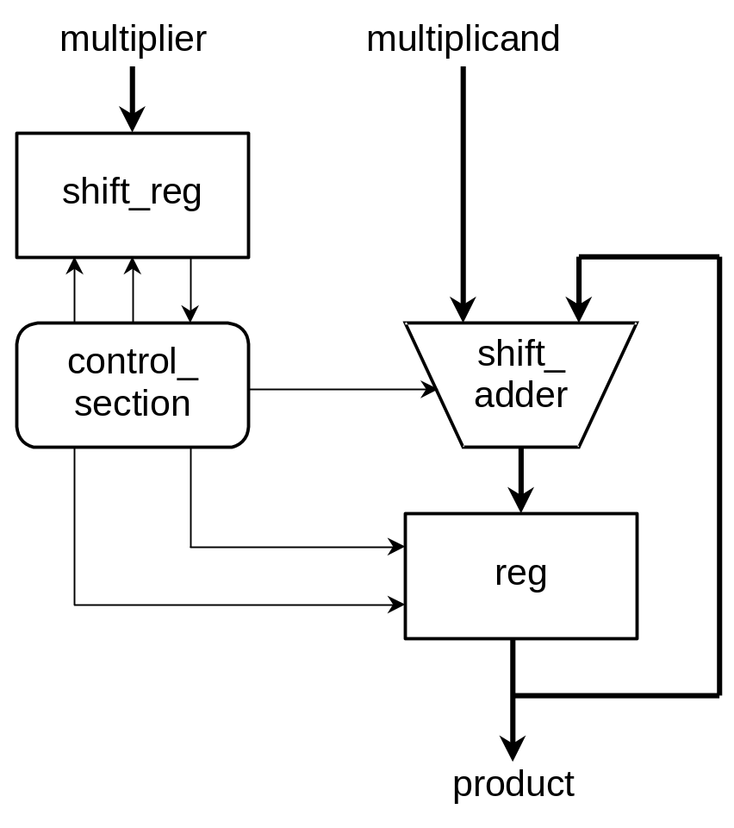
Mixed Example

Slide 11
Mixed Example
entity multiplier is
port ( clk, reset : in bit;
multiplicand, multiplier : in integer;
product : out integer );
end entity multiplier;
architecture mixed of mulitplier is
signal partial_product, full_product : integer;
signal arith_control, result_en, mult_bit, mult_load : bit;
begin
arith_unit : entity work.shift_adder(behavior)
port map ( addend => multiplicand, augend => full_product,
sum => partial_product,
add_control => arith_control );
result : entity work.reg(behavior)
port map ( d => partial_product, q => full_product,
en => result_en, reset => reset );
...

Slide 12
Mixed Example
…
multiplier_sr : entity work.shift_reg(behavior)
port map ( d => multiplier, q => mult_bit,
load => mult_load, clk => clk );
product <= full_product;
control_section : process is
-- variable declarations for control_section
-- …
begin
-- sequential statements to assign values to control signals
-- …
wait on clk, reset;
end process control_section;
end architecture mixed;

Slide 13
Test Benches
Testing a design by simulation
Use a test bench model
  an architecture body that includes an instance of the design under test
  applies sequences of test values to inputs
  monitors values on output signals
    either using simulator
    or with a process that verifies correct operation

Slide 14
Regression Testing
Test that a refinement of a design is correct
  that lower-level structural model does the same as a behavioral model
Test bench includes two instances of design under test
  behavioral and lower-level structural
  stimulates both with same inputs
  compares outputs for equality
Need to take account of timing differences

Slide 15
Design Processing
Analysis
Elaboration
Simulation
Synthesis

Slide 16
Analysis
Check for syntax and semantic errors
  syntax: grammar of the language
  semantics: the meaning of the model
Analyze each design unit separately
  entity declaration
  architecture body
  …
  best if each design unit is in a separate file
Analyzed design units are placed in a library
  in an implementation dependent internal form
  current library is called work

Slide 17
Elaboration
“Flattening” the design hierarchy
  create ports
  create signals and processes within architecture body
  for each component instance, copy instantiated entity and architecture body
  repeat recursively
    bottom out at purely behavioral architecture bodies
Final result of elaboration
  flat collection of signal nets and processes

Slide 18
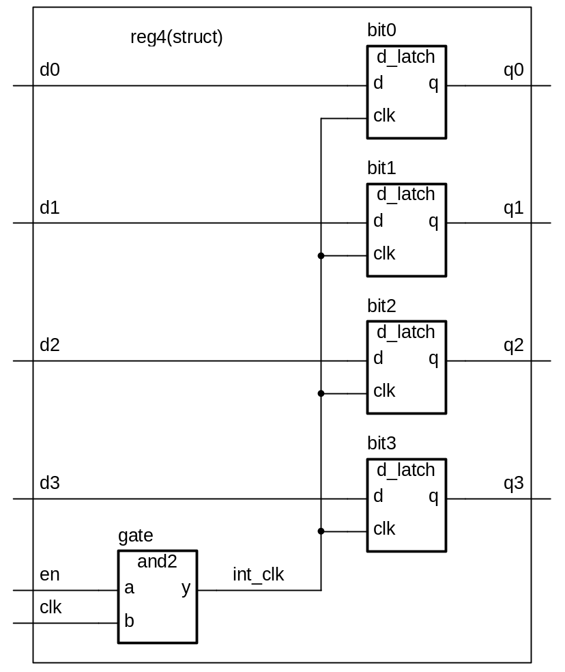
Elaboration Example

Slide 19
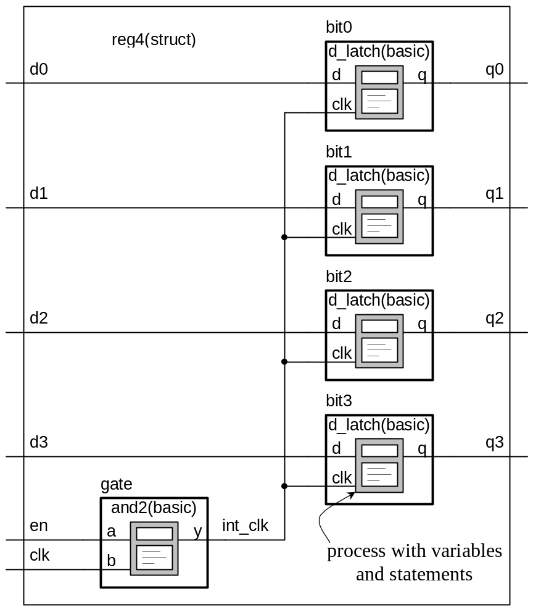
Elaboration Example

Slide 20
Simulation
Execution of the processes in the elaborated model
Discrete event simulation
  time advances in discrete steps
  when signal values change—events
A processes is sensitive to events on input signals
  specified in wait statements
  resumes and schedules new values on output signals
    schedules transactions
    event on a signal if new value different from old value

Slide 21
Simulation Algorithm
Simulation cycle
  advance simulation time to time of next transaction
  for each transaction at this time
    update signal value
      event if new value is different from old value
  for each process sensitive to any of these events, or whose “wait for …” time-out has expired
    resume
    execute until a wait statement, then suspend
Simulation finishes when there are no further scheduled transactions

Slide 22
Synthesis
Translates register-transfer-level (RTL) design into gate-level netlist
Restrictions on coding style for RTL model
Tool dependent
  see lab notes

Slide 23

Basic Design Methodology
Requirements
RTL Model
Simulate
Synthesize
Gate-level
Model
Simulate
Test Bench
ASIC or FPGA
Place & Route
Timing
Model
Simulate

